Slide 1
Diffusion & Score
Hans van Gorp - 2023/03/24
For the code, see this GitHub

Slide 2
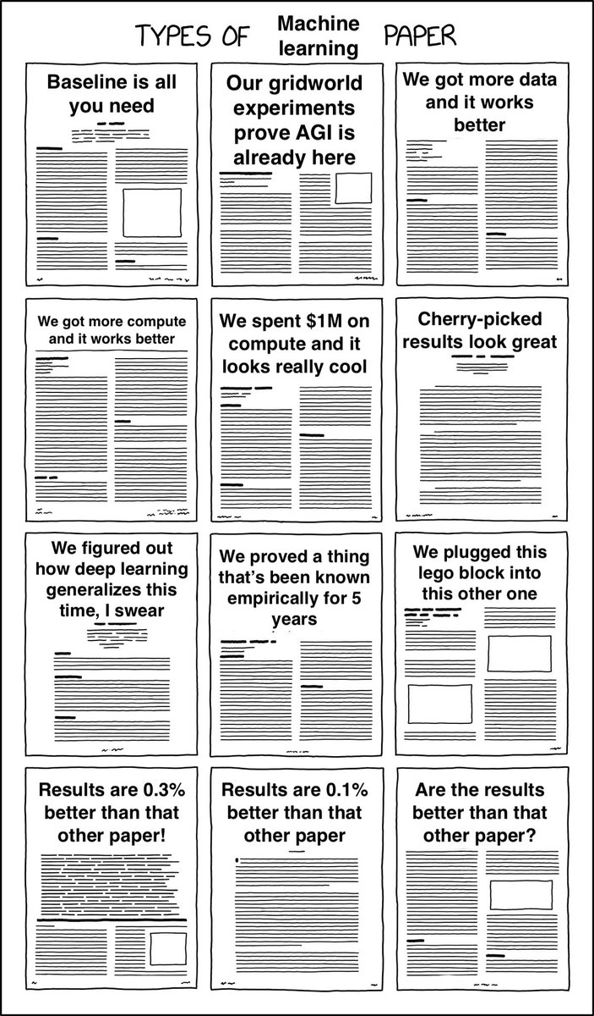
Types of Machine Learning Papers:

Slide 3
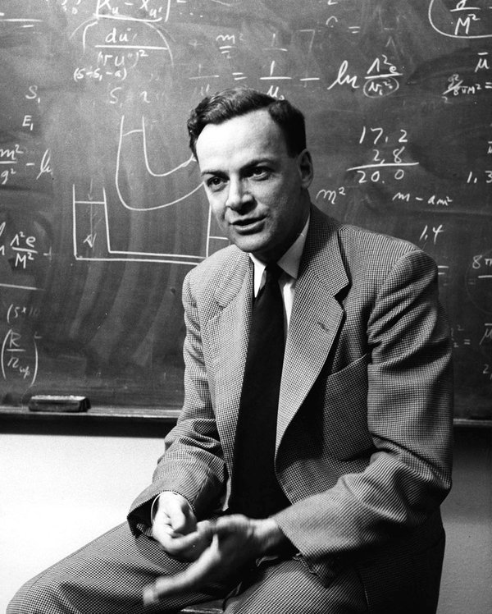
The Feynman Technique
Teach the concept
Identify gaps in your knowledge
Organize and simplify

Slide 4
Generative Modeling
Creating noise from data is easy;
Creating data from noise is generative modeling
GM
z
x

Slide 5
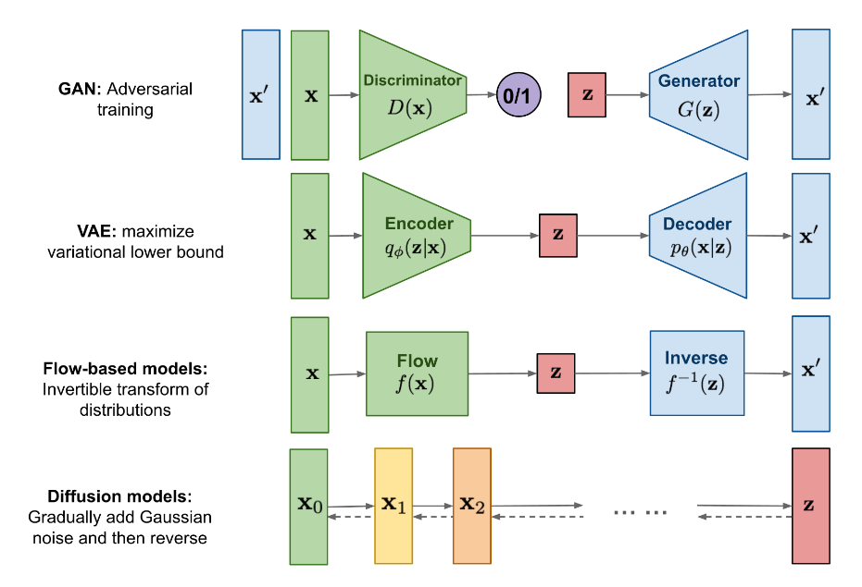
Generative Modeling
Generate x from z
in a single pass
Generate x from z
using an iterative scheme
Notes:
https://lilianweng.github.io/posts/2021-07-11-diffusion-models/

Slide 6

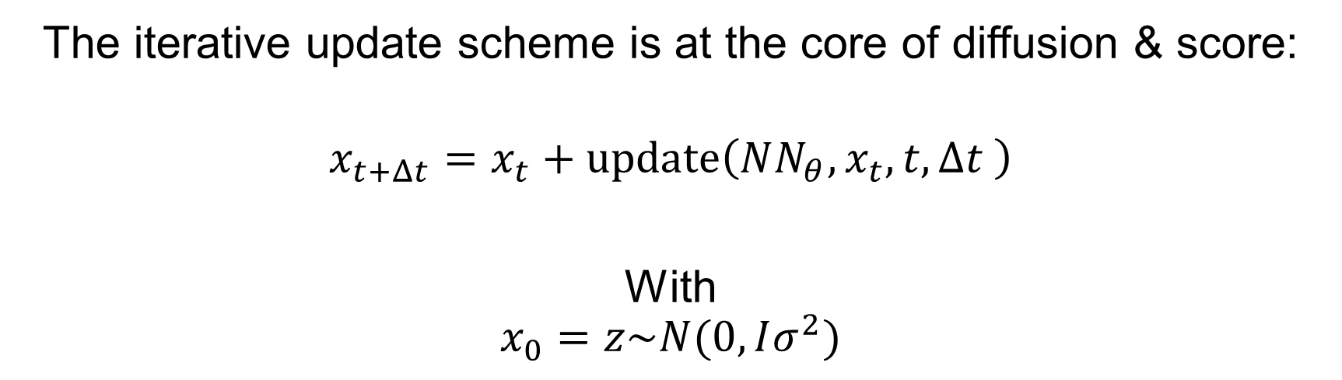



GM using update rules
$$x_{0}$$
$$x_{2}$$
$$x_{1}$$
$$x_{T}$$
…
The iterative update scheme is at the core of diffusion & score:
$$x_{t+Δt}=x_{t}+update\left({NN_{θ},x}_{t}, t,Δt \right)$$
With
$$x_{0}=z\sim N(0,Iσ^{2})$$

Slide 7
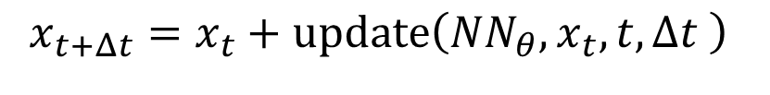
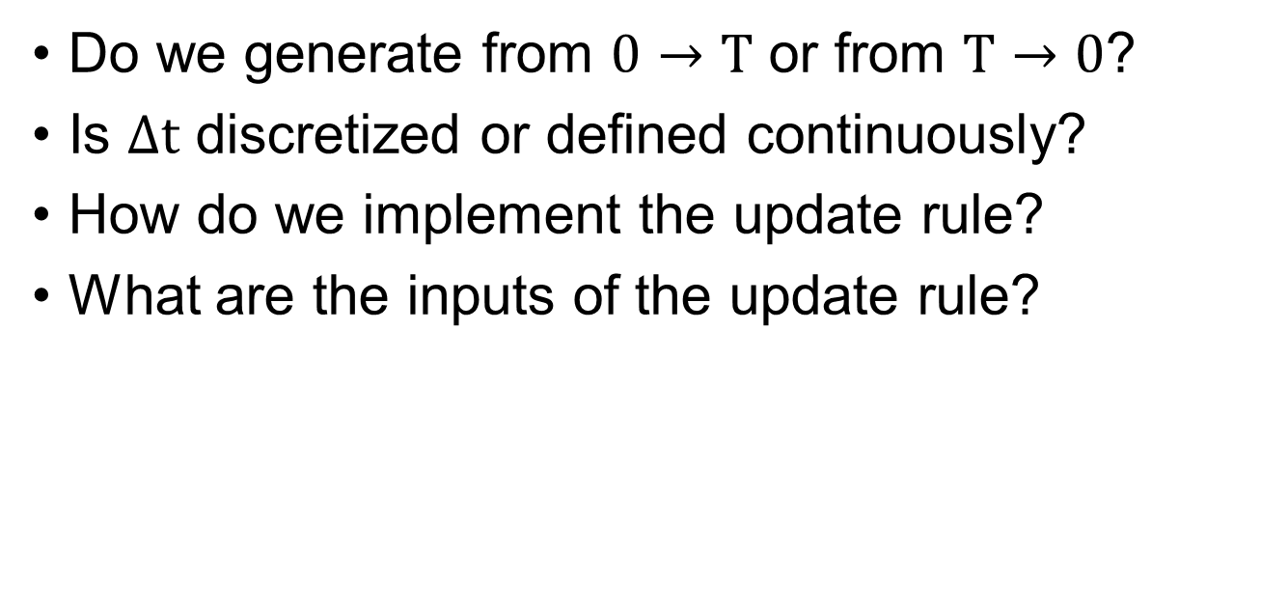
The Mess…
$$x_{t+Δt}=x_{t}+update\left({NN_{θ},x}_{t}, t,Δt \right)$$
Do we generate from $0→T$ or from $T→0$?
Is $Δt$ discretized or defined continuously?
How do we implement the update rule?
What are the inputs of the update rule?

Slide 8
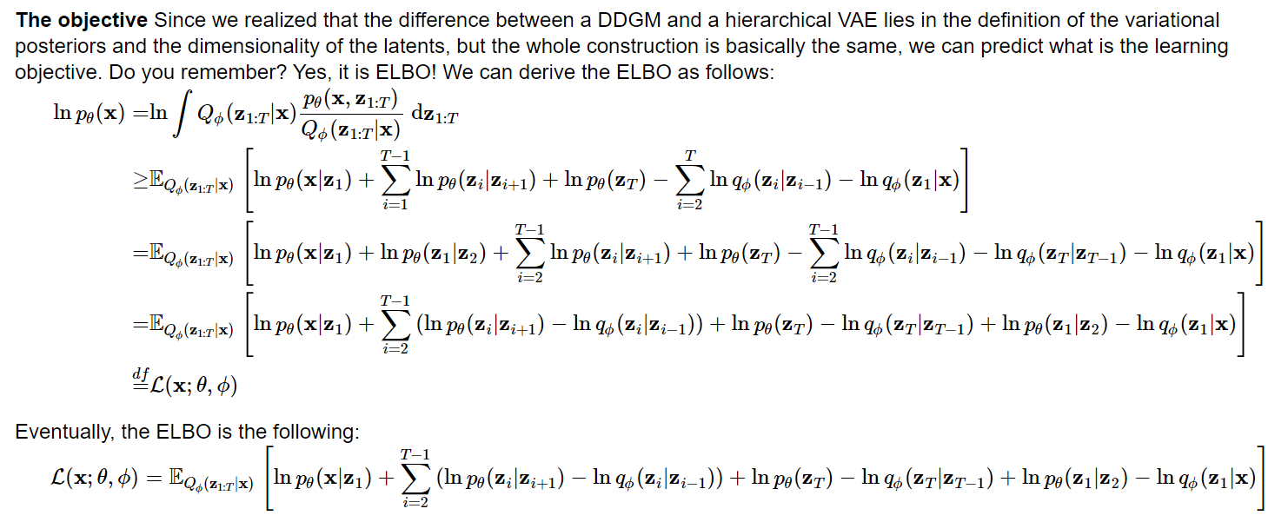
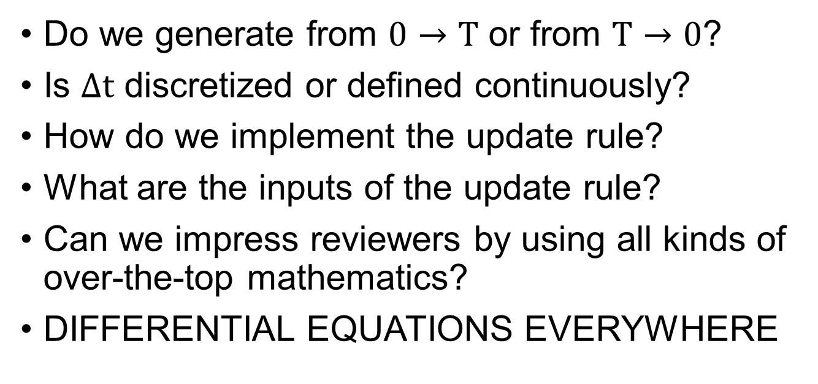
The Mess…
$$x_{t+Δt}=x_{t}+update\left({NN_{θ},x}_{t}, t,Δt \right)$$
Do we generate from $0→T$ or from $T→0$?
Is $Δt$ discretized or defined continuously?
How do we implement the update rule?
What are the inputs of the update rule?
Can we impress reviewers by using all kinds of over-the-top mathematics?
DIFFERENTIAL EQUATIONS EVERYWHERE

Slide 9
The rest of this presentation
The toy example
Score
diffusion
Conclusion

Slide 10
Toy Example

Slide 11
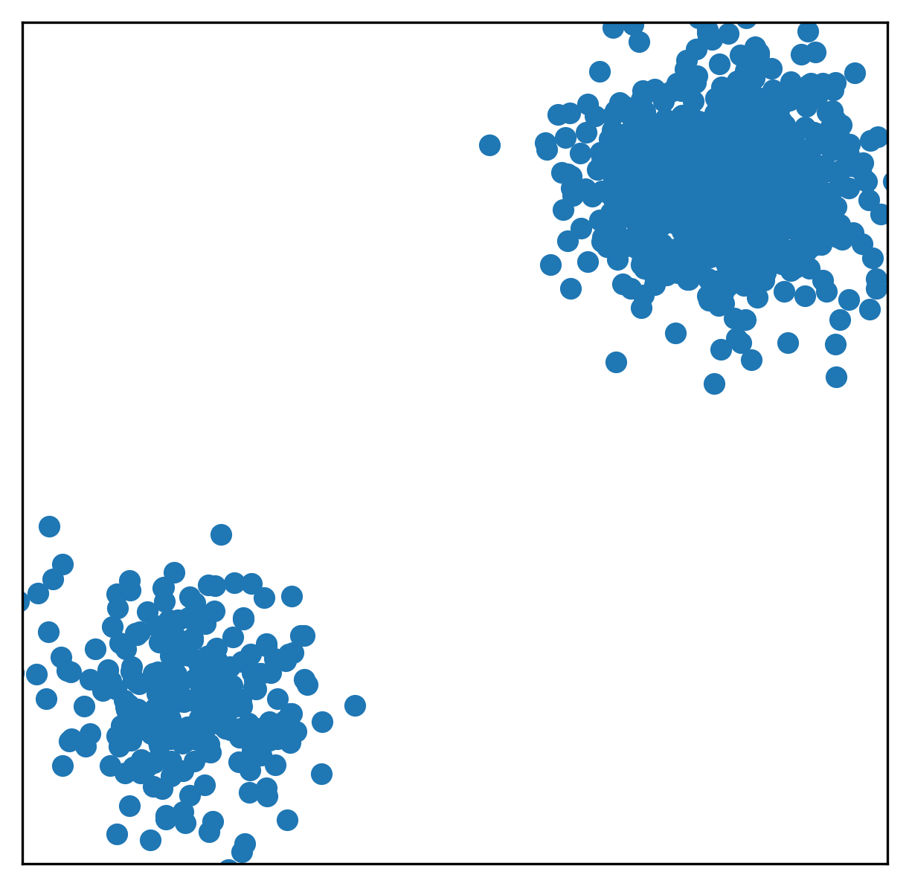
The data
Suppose we have bimodal data of the following form:

Slide 12
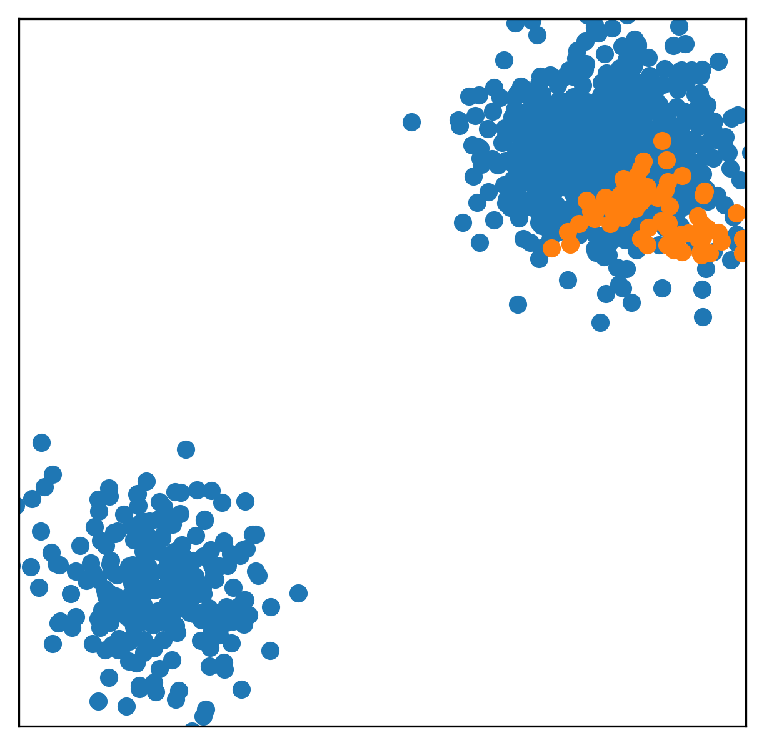
The data
Generating new data using a
GAN

Slide 13
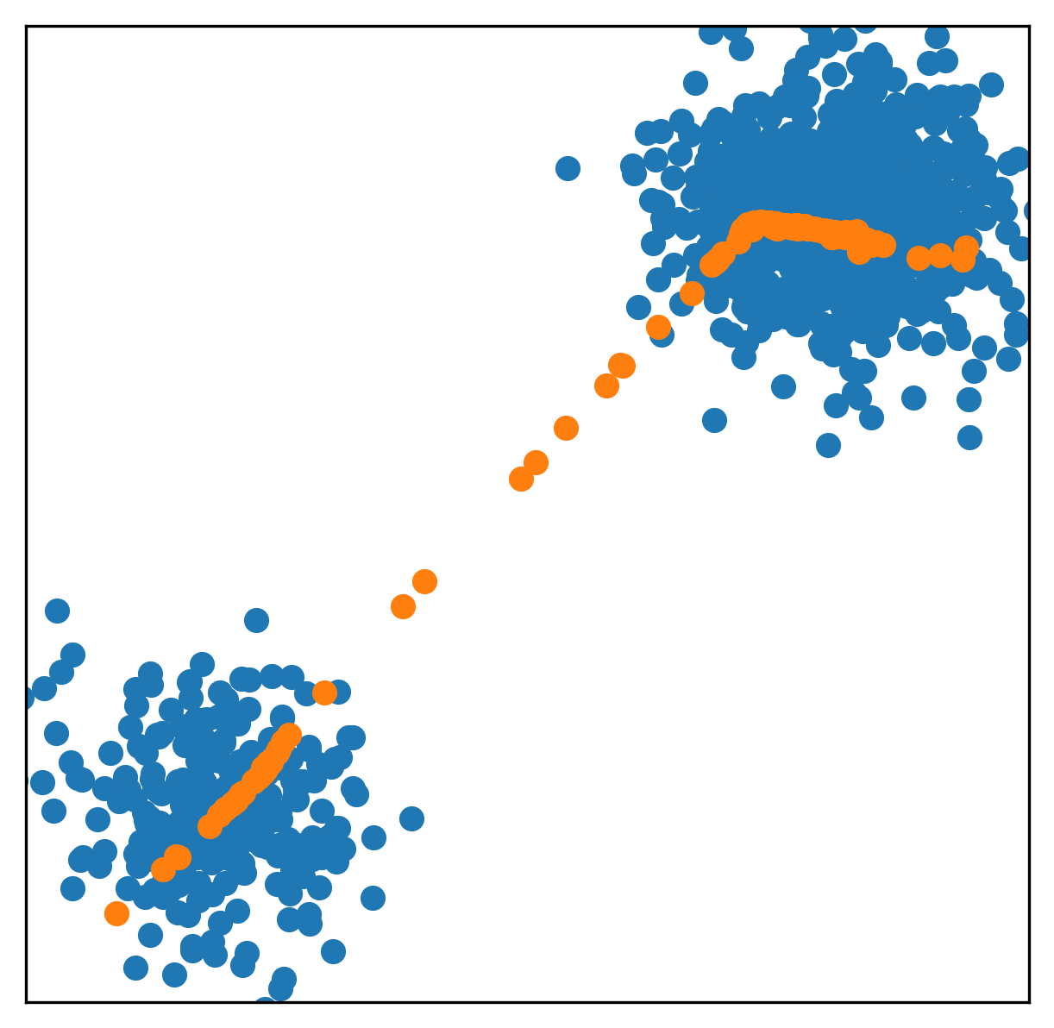
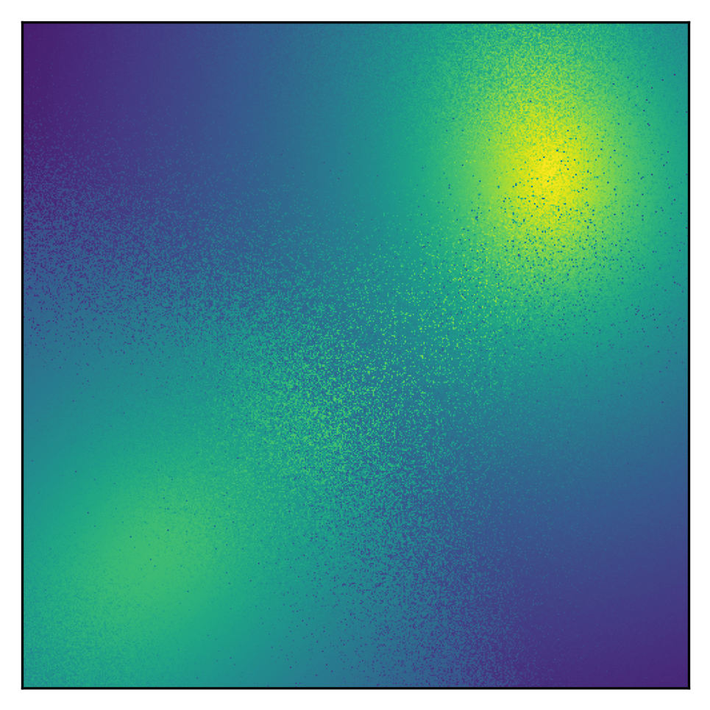
The data
Generating new data using a VAE
ELBO of VAE

Slide 14
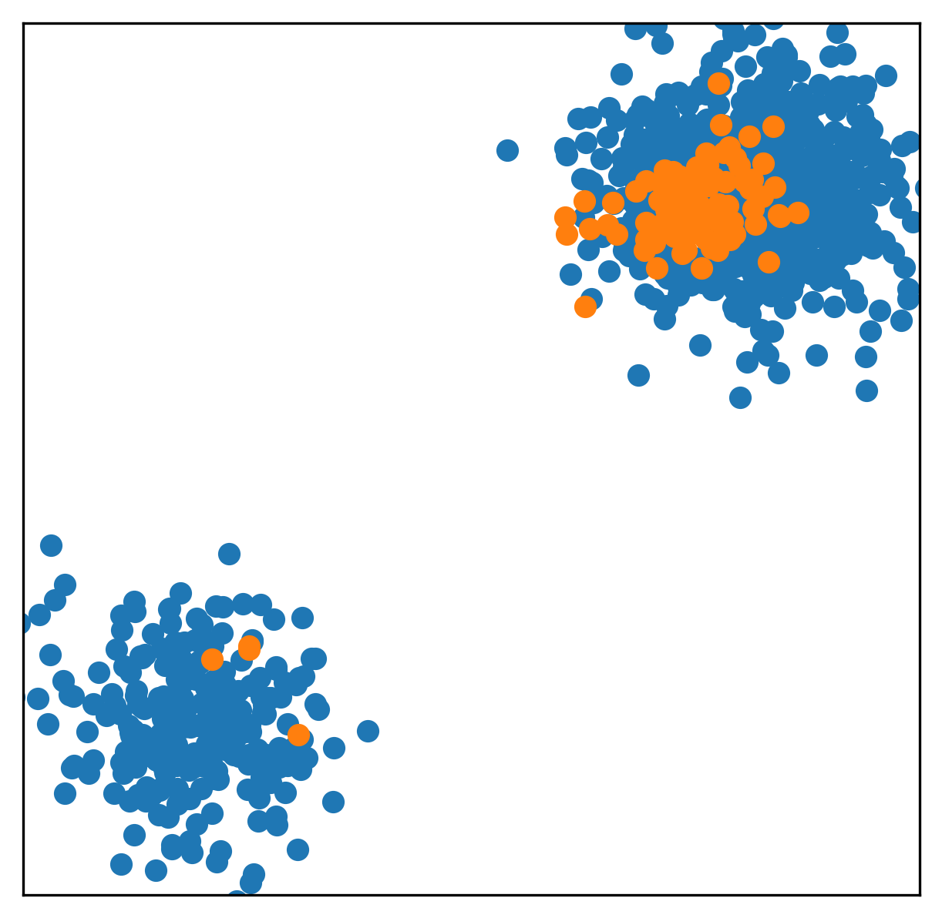
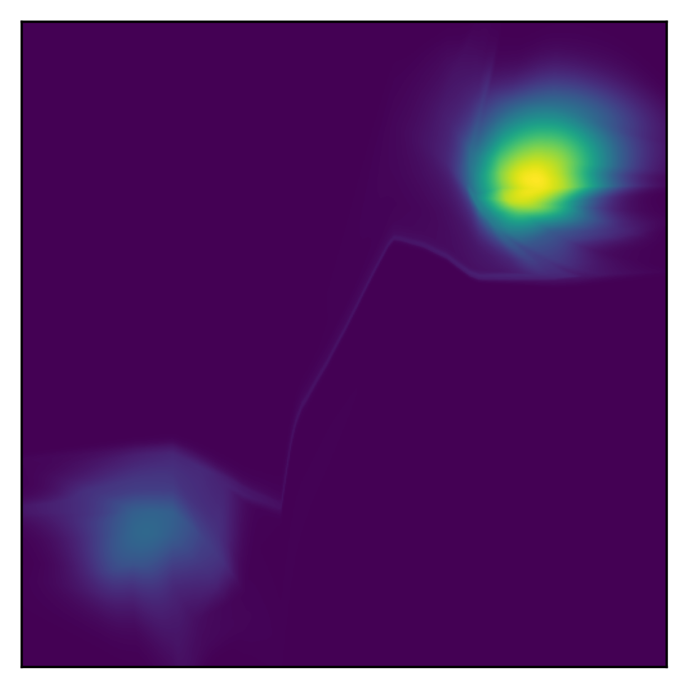
The data
Generating new data using a Flow
Likelihood of that Flow
(spot the tiny connection)

Slide 15
Score
“Generative Modeling by Estimating Gradients of the Data Distribution”
Yang Song and Stefano Ermon

Slide 16
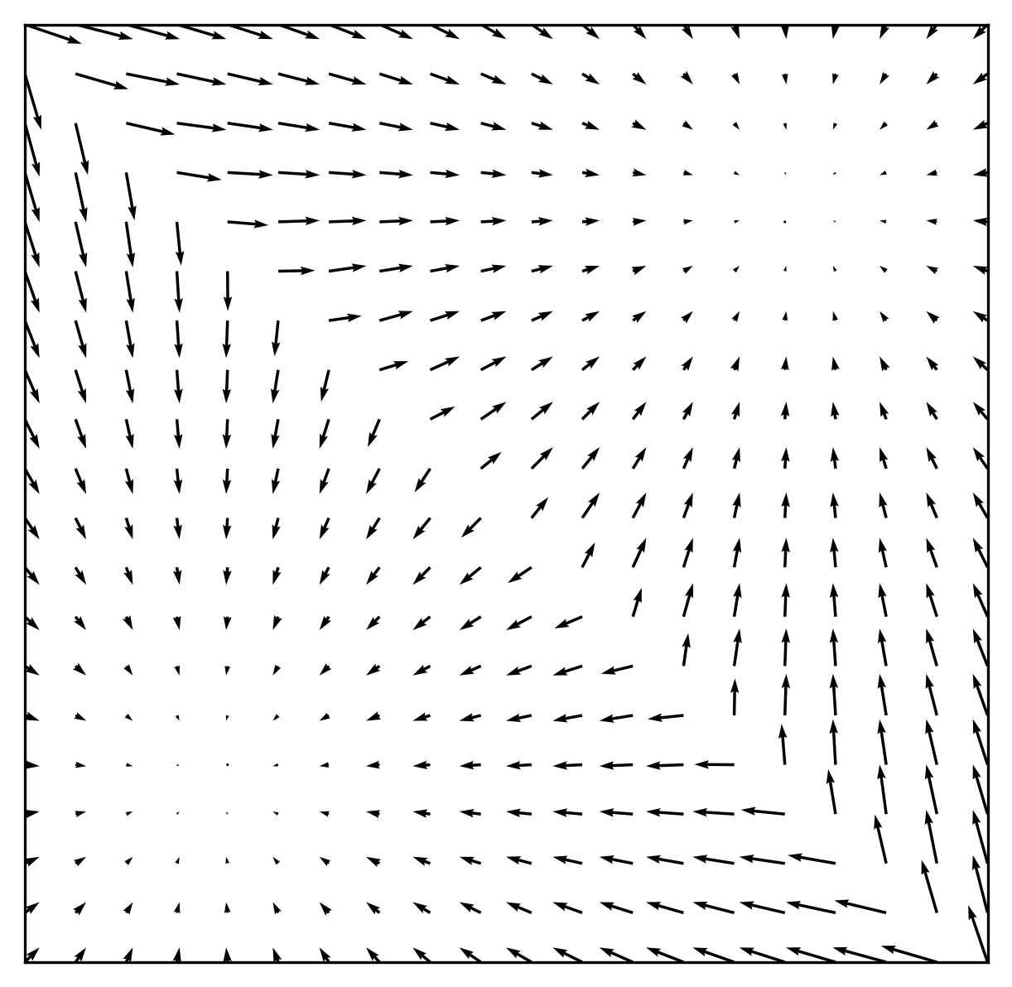


What is a score?
A score is a gradient field pointing in the direction of the data:
$$\left\{x_{1},x_{2},..,x_{N}\right\}\sim p(x)$$
$$s_{θ}\left(x\right)≈∇_{x}\log{p\left(x\right)}$$

Slide 17
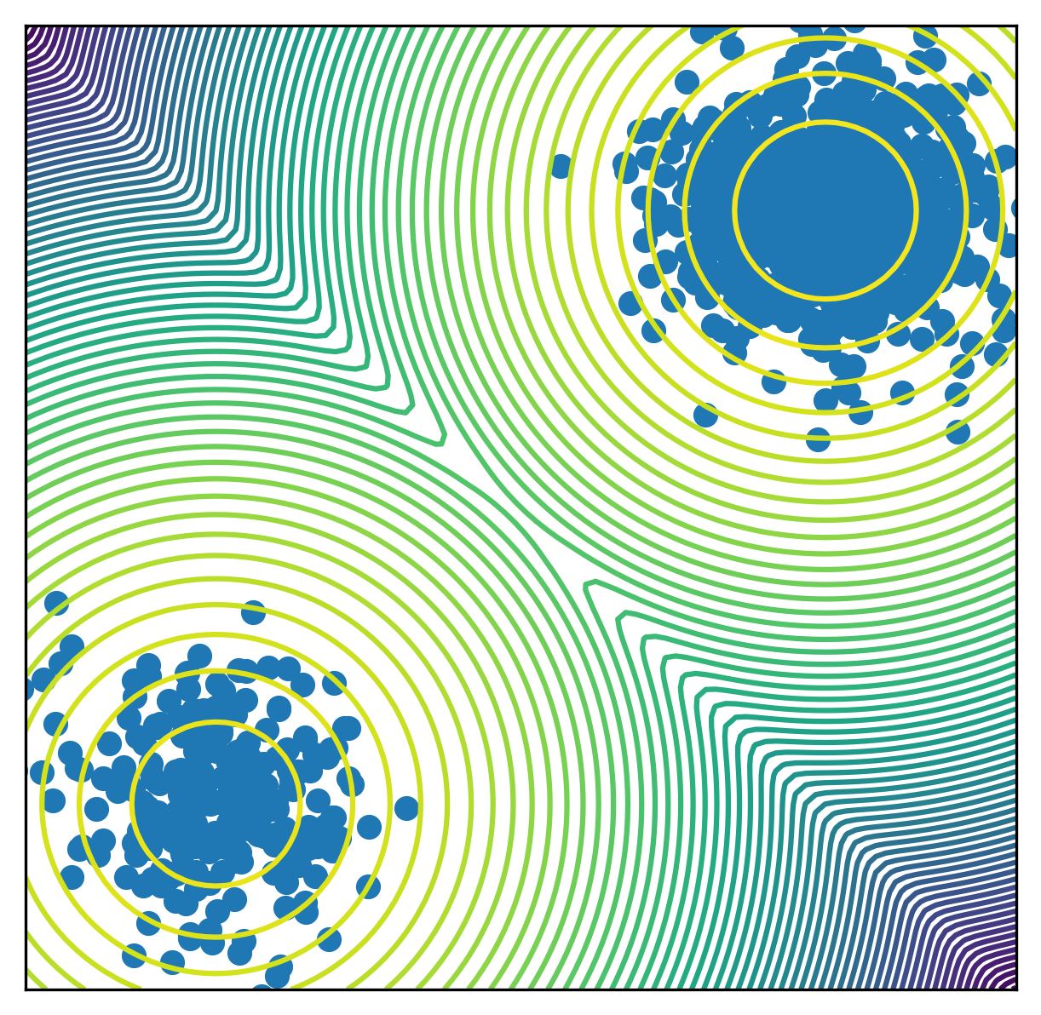

What is a score?
A score is a gradient field pointing in the direction of the data:
I chose $p(x)$ myself
So, I know the score analytically:
$$\left\{x_{1},x_{2},..,x_{N}\right\}\sim p(x)$$
$$s_{θ}\left(x\right)≈∇_{x}\log{p\left(x\right)}$$

Slide 18
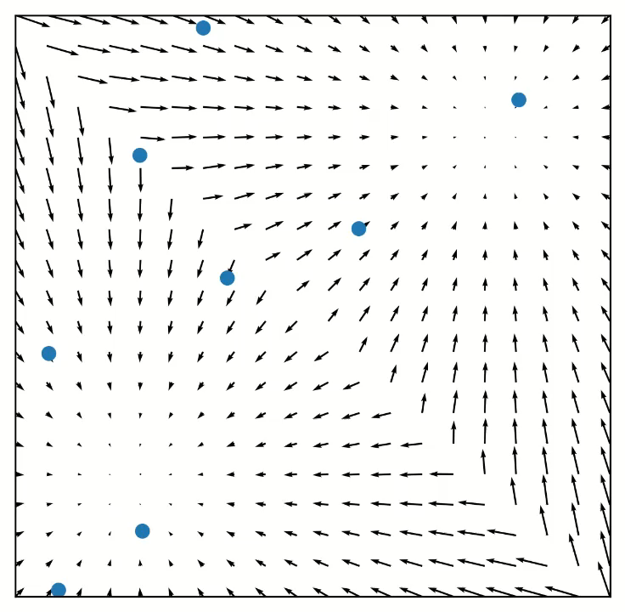
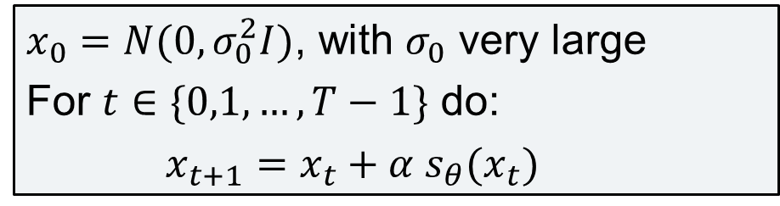
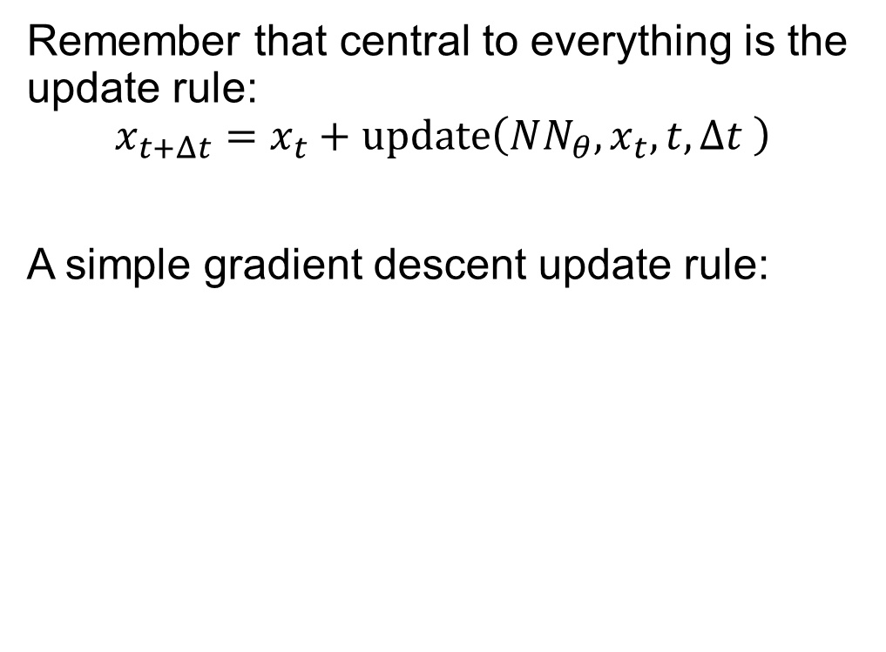
Update rule
Remember that central to everything is the update rule:
$$x_{t+Δt}=x_{t}+update\left({NN_{θ},x}_{t}, t,Δt \right)$$
A simple gradient descent update rule:
$x_{0}=N(0,σ_{0}^{2}I)$, with $σ_{0}$ very large
For $t∈\{0,1,…,T−1\}$ do:
$x_{t+1}=x_{t}+α s_{θ}(x_{t})$

Slide 19
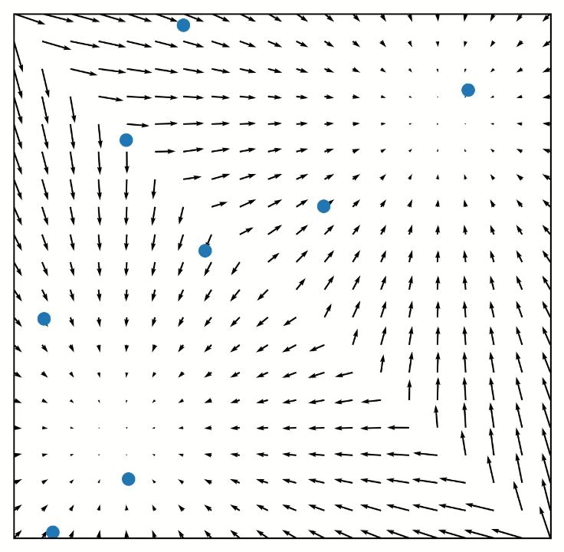
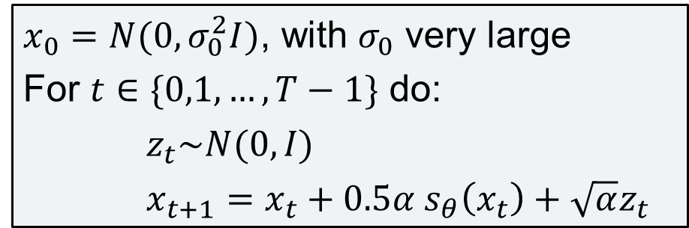
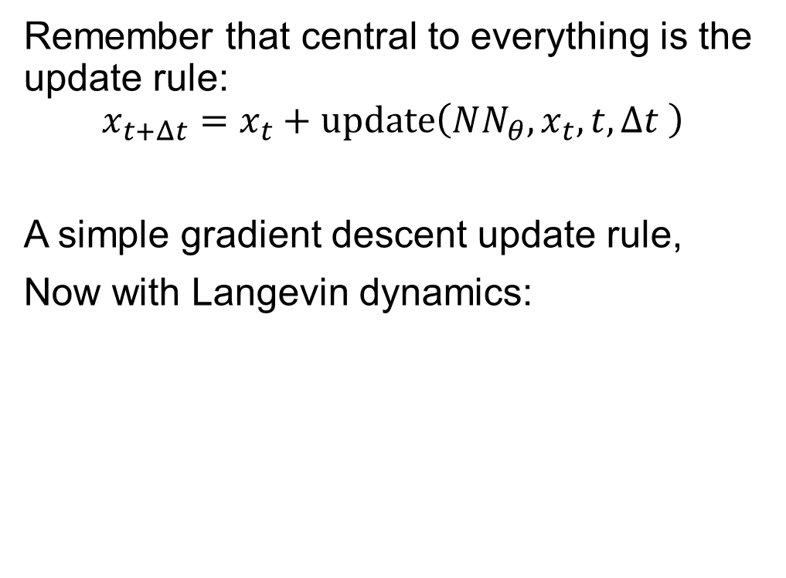
Update rule
Remember that central to everything is the update rule:
$$x_{t+Δt}=x_{t}+update\left({NN_{θ},x}_{t}, t,Δt \right)$$
A simple gradient descent update rule,
Now with Langevin dynamics:
$x_{0}=N(0,σ_{0}^{2}I)$, with $σ_{0}$ very large
For $t∈\{0,1,…,T−1\}$ do:
$z_{t}\sim N(0,I)$
$x_{t+1}=x_{t}+0.5α s_{θ}\left(x_{t}\right)+\sqrt{α}z_{t}$
This is the true score, yet our representation is not proportional, we will get back to this later…

Slide 20
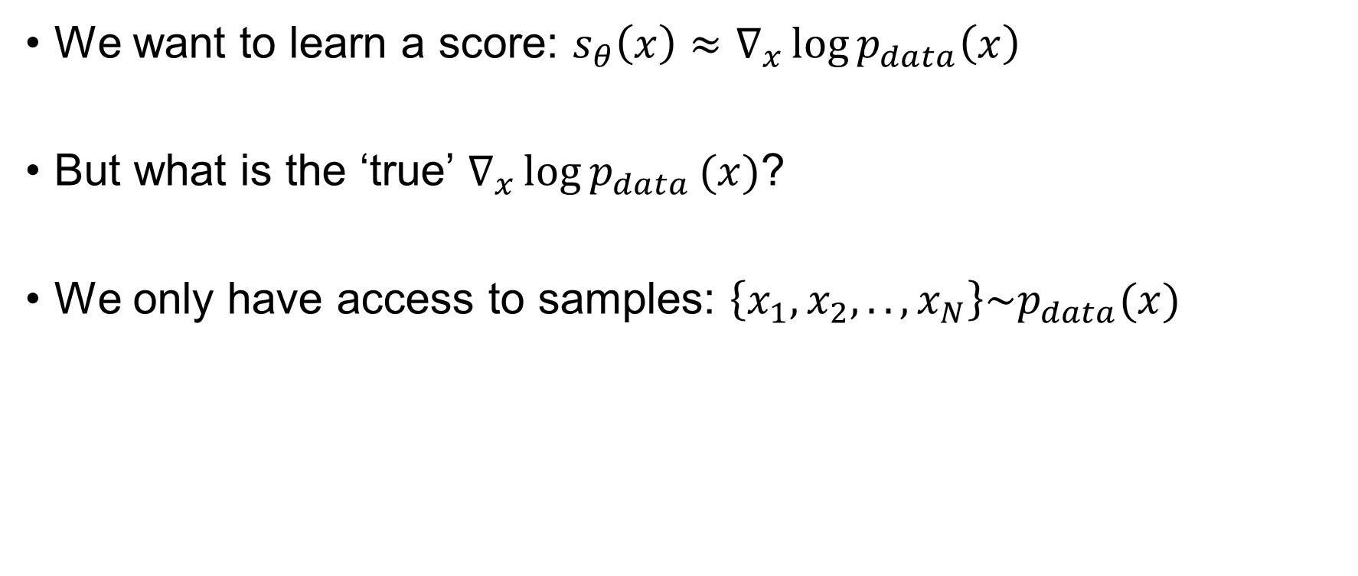
Learning the score
We want to learn a score: $s_{θ}\left(x\right)≈∇_{x}\log{p_{data}\left(x\right)}$
But what is the ‘true’ $∇_{x}\log{p_{data}}(x)$?
We only have access to samples: $\left\{x_{1},x_{2},..,x_{N}\right\}\sim p_{data}(x)$

Slide 21
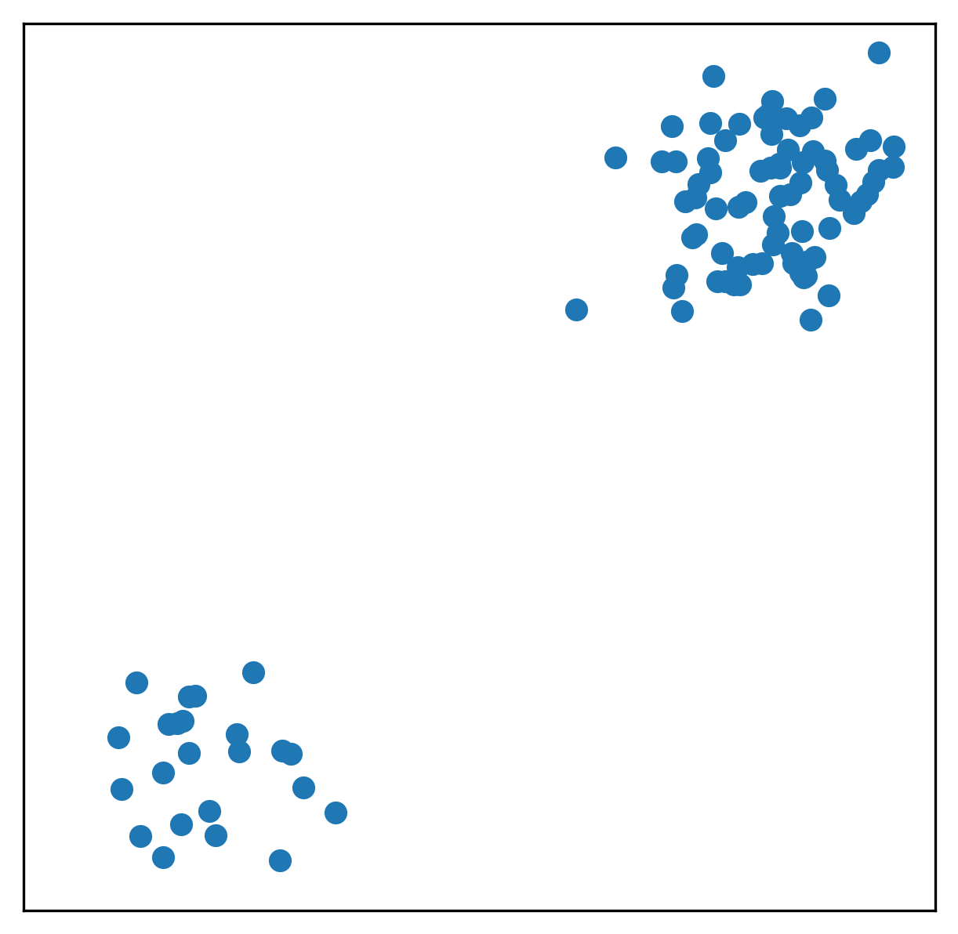
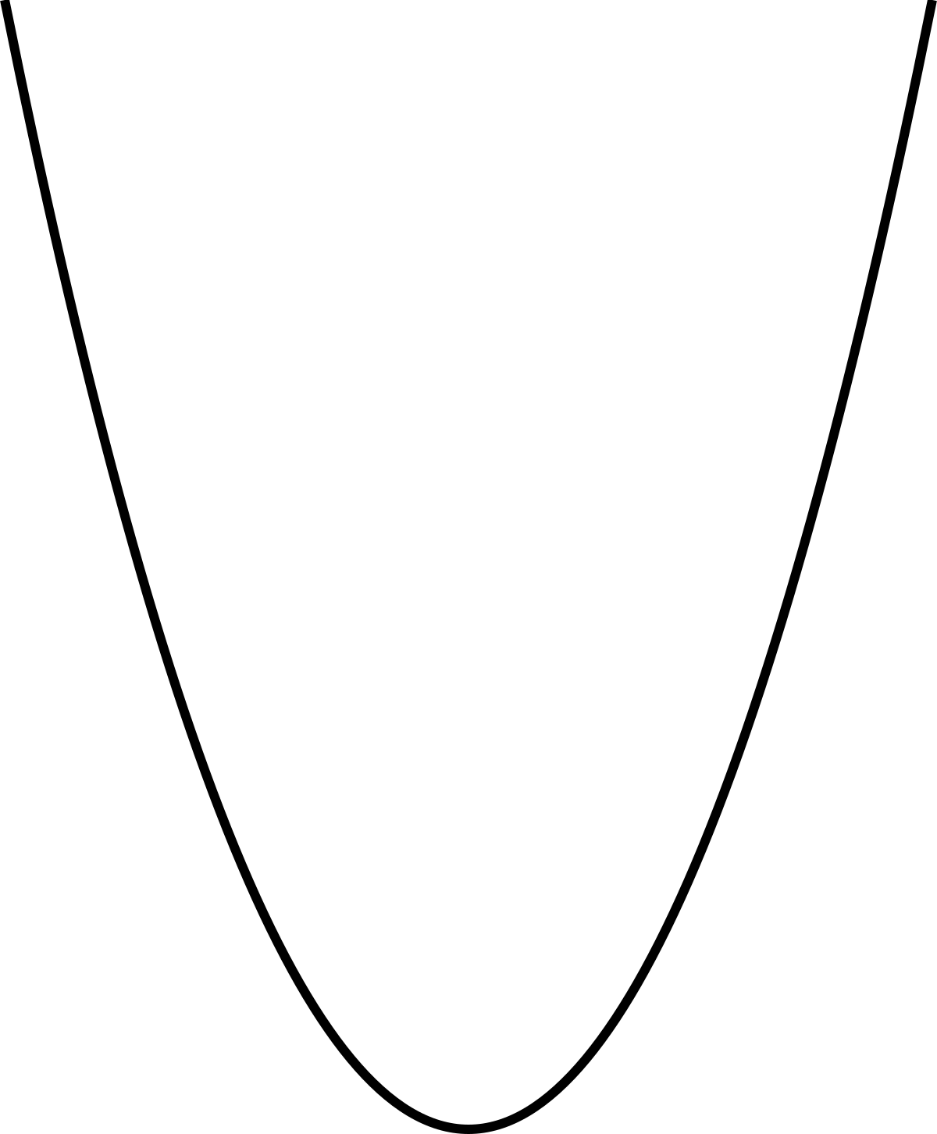
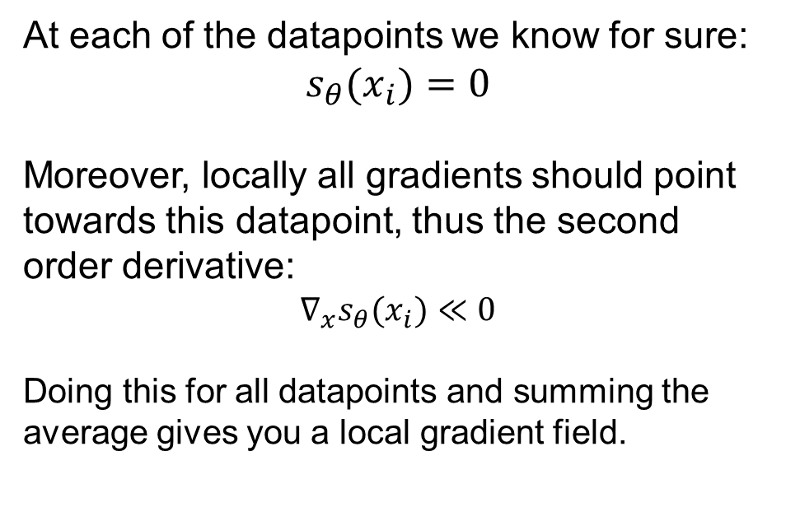
Learning the score
The old method used the first and second order derivative:
We can learn both equations at all the data points, but what about the rest of the space?
At each of the datapoints we know for sure:
$$s_{θ}(x_{i})=0$$
Moreover, locally all gradients should point towards this datapoint, thus the second order derivative:
$$∇_{x}s_{θ}(x_{i})≪0$$
Doing this for all datapoints and summing the average gives you a local gradient field.

Slide 22
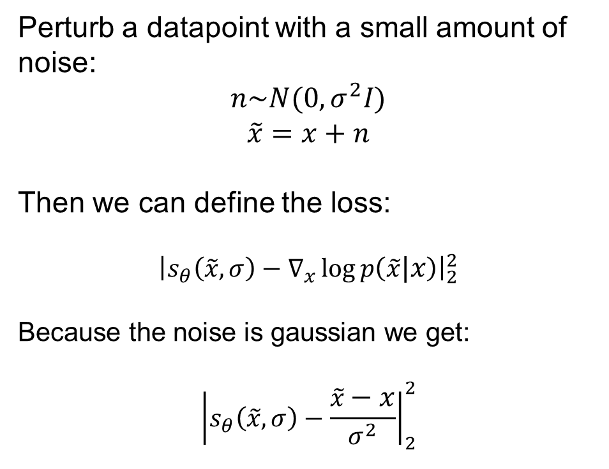
Learning the score
Another option is to introduce small perturbations:
Perturb a datapoint with a small amount of noise:
$$n\sim N(0,σ^{2}I)$$
$$\tilde{x}=x+n$$
Then we can define the loss:
$${\left|s_{θ}\left(\tilde{x},σ\right)−∇_{x}\log{p\left(\tilde{x}|x\right)}\right|}_{2}^{2}$$
Because the noise is gaussian we get:
$${\left|s_{θ}\left(\tilde{x},σ\right)−\frac{\tilde{x}−x}{σ^{2}}\right|}_{2}^{2}$$

Slide 23
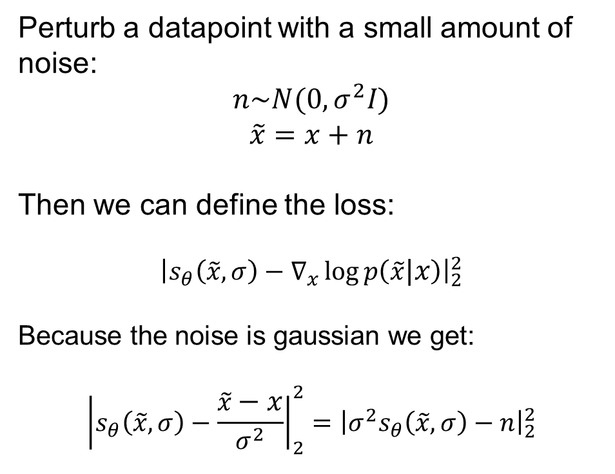
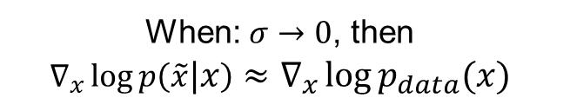
Learning the score
Another option is to introduce small perturbations:
Perturb a datapoint with a small amount of noise:
$$n\sim N(0,σ^{2}I)$$
$$\tilde{x}=x+n$$
Then we can define the loss:
$${\left|s_{θ}\left(\tilde{x},σ\right)−∇_{x}\log{p\left(\tilde{x}|x\right)}\right|}_{2}^{2}$$
Because the noise is gaussian we get:
$${\left|s_{θ}\left(\tilde{x},σ\right)−\frac{\tilde{x}−x}{σ^{2}}\right|}_{2}^{2}={\left|σ^{2}s_{θ}\left(\tilde{x},σ\right)−n\right|}_{2}^{2}$$
When: $σ→0$, then
$$∇_{x}\log{p\left(\tilde{x}|x\right)}≈∇_{x}\log{p_{data}(x)}$$

Slide 24
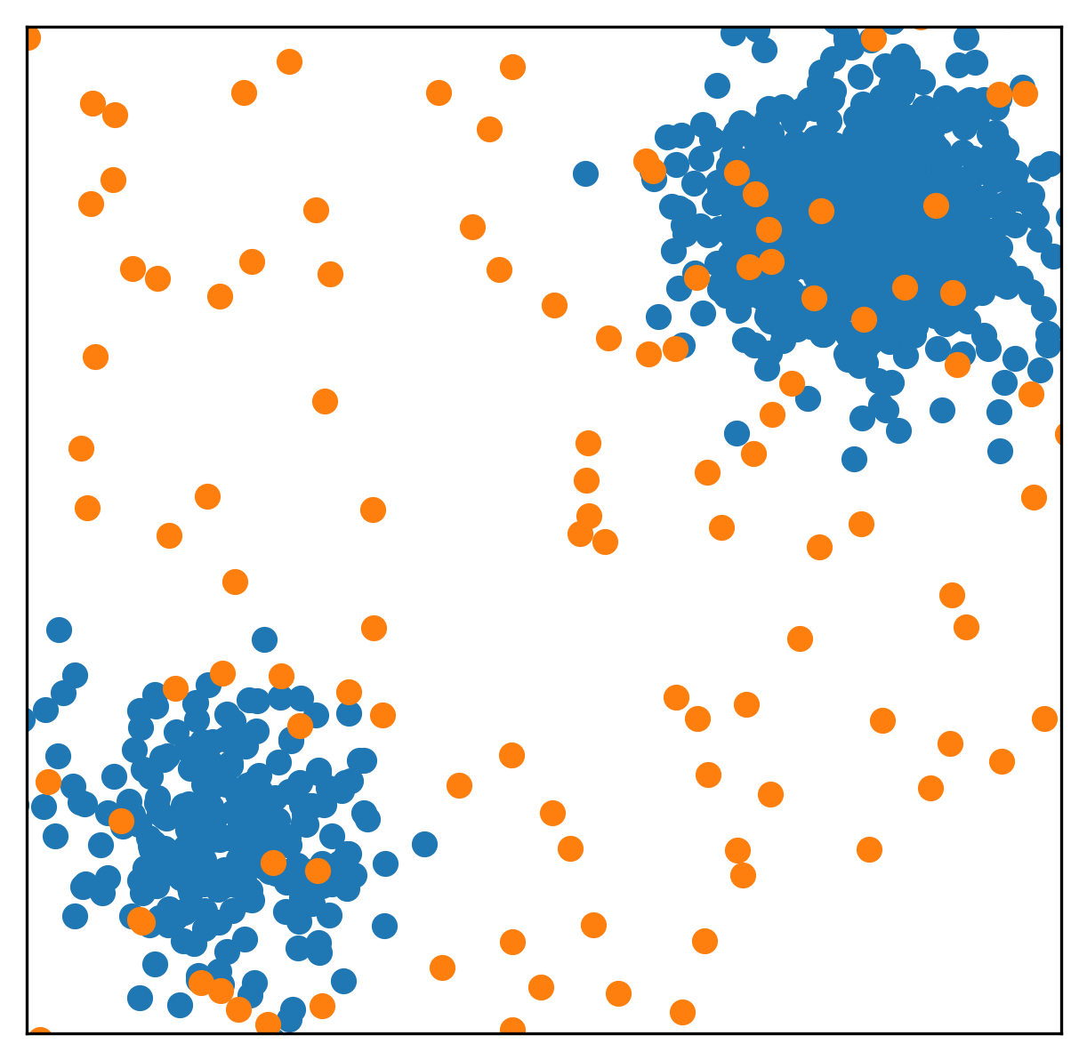
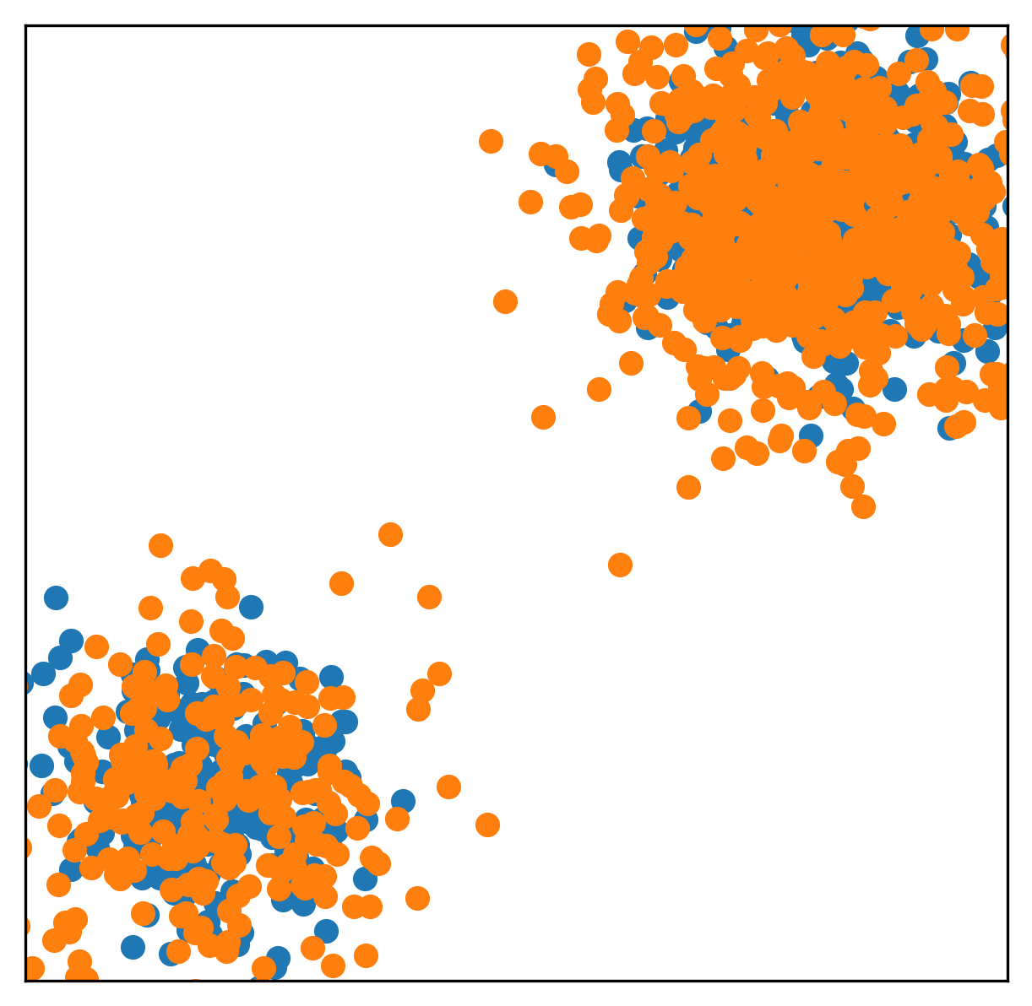
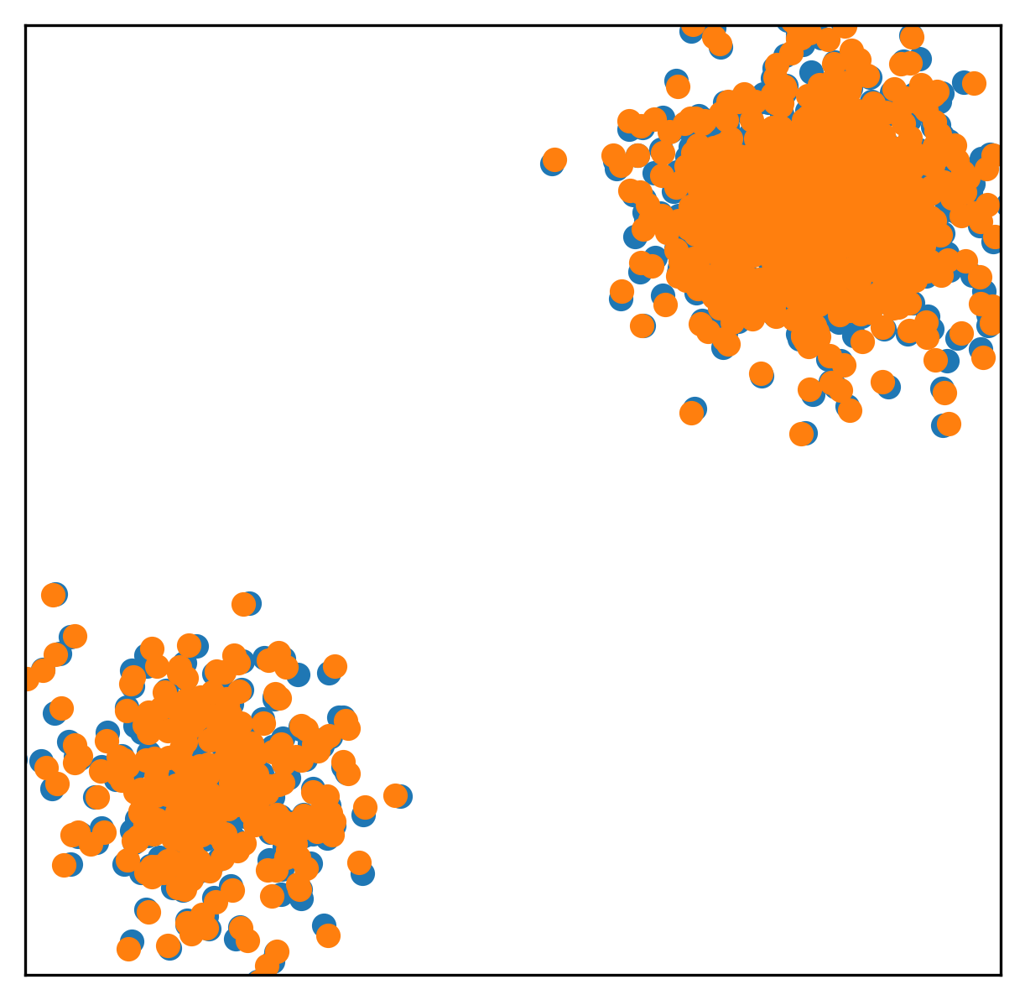
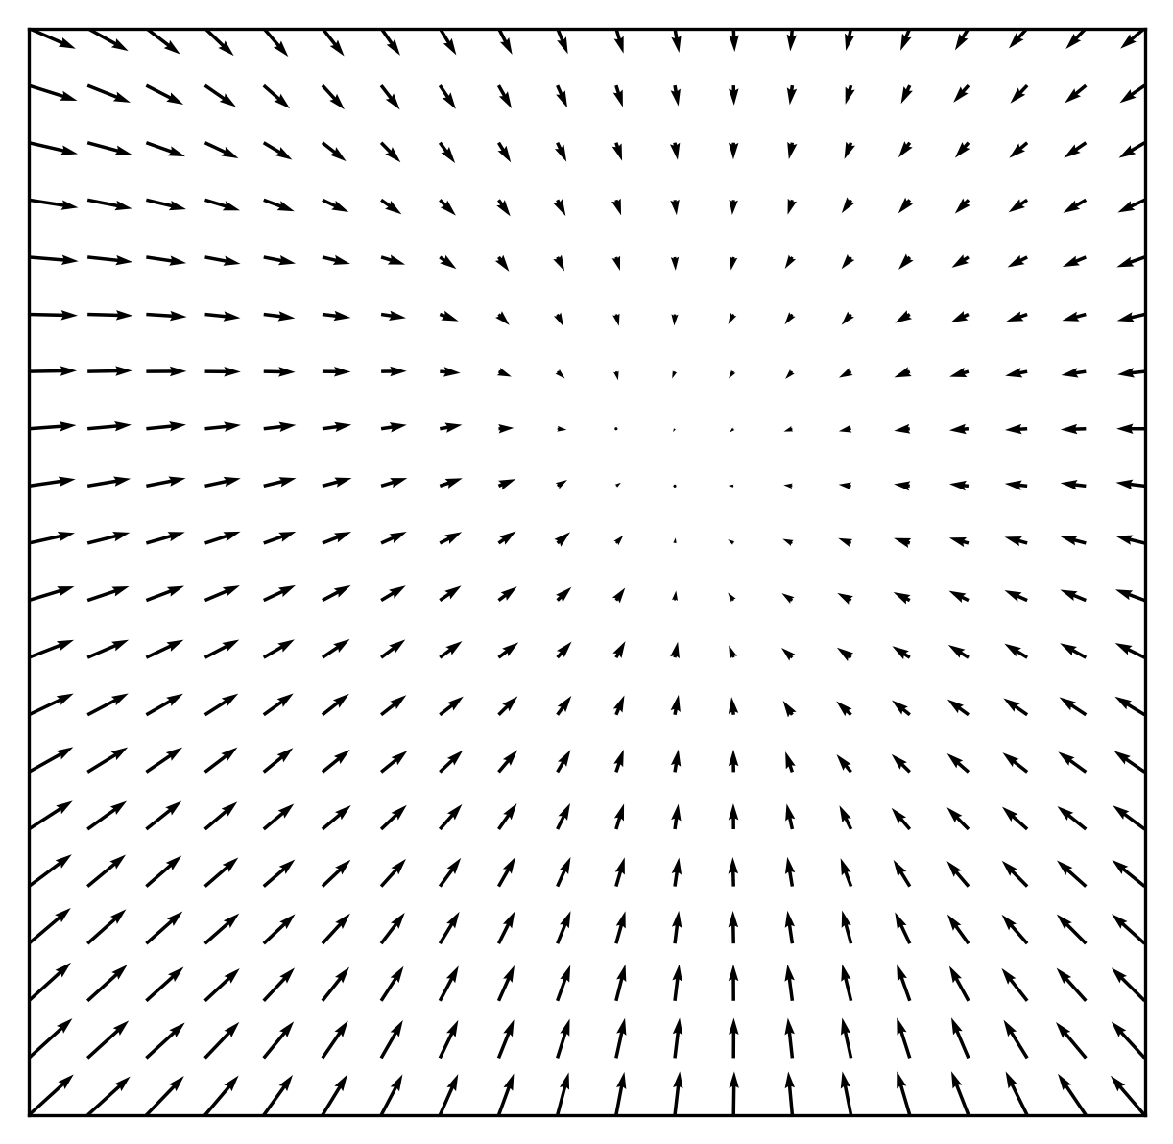
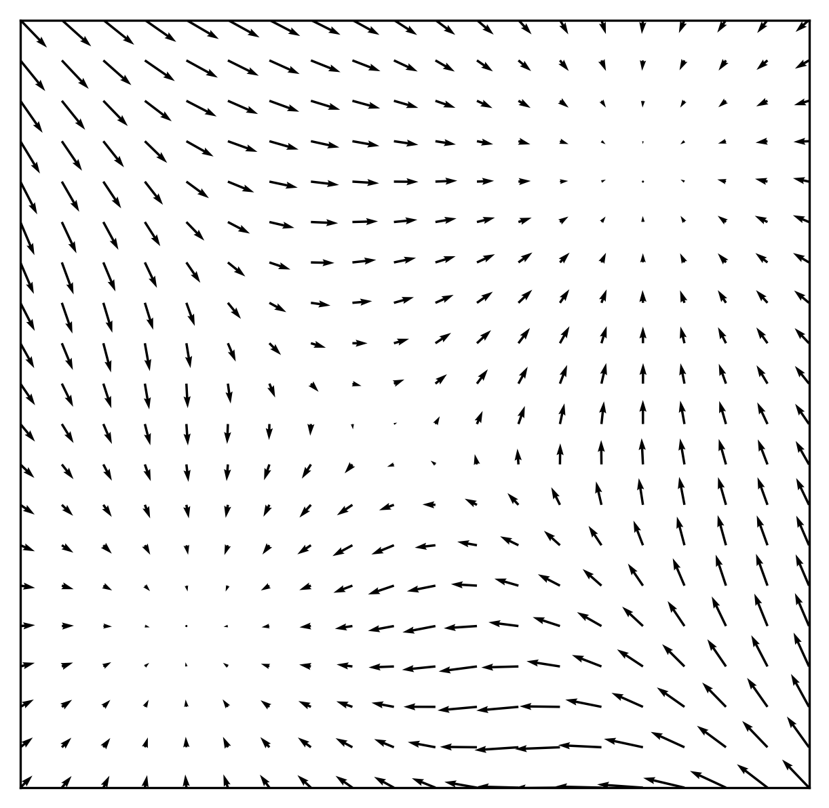
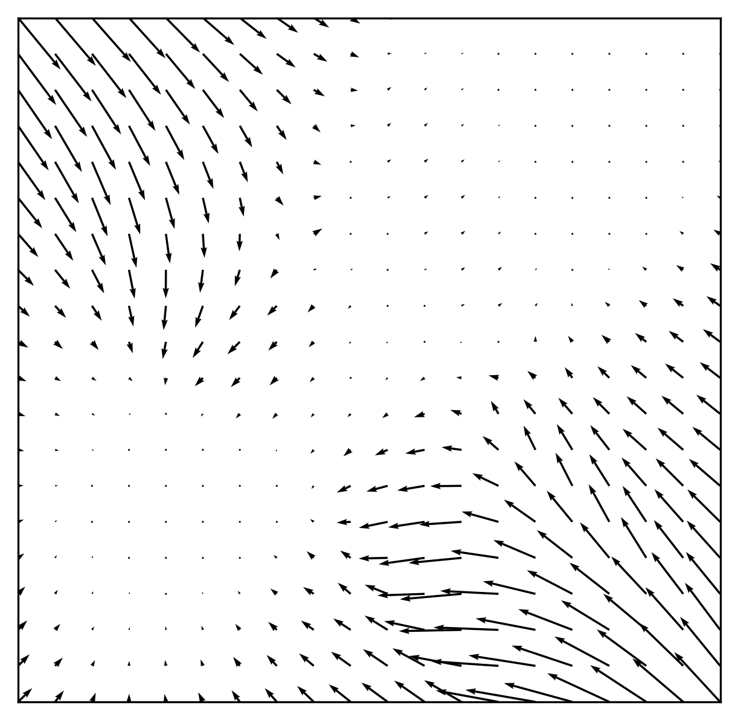



Learning the score
Learning it using different noise perturbations:
$$σ=4$$
$$σ=1$$
$$σ=0.25$$

Slide 25
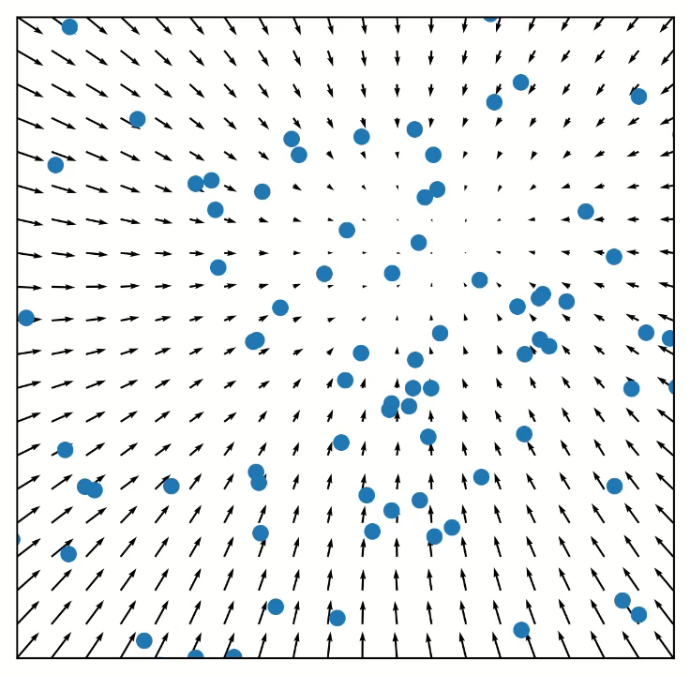
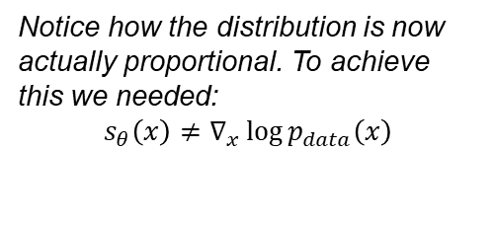
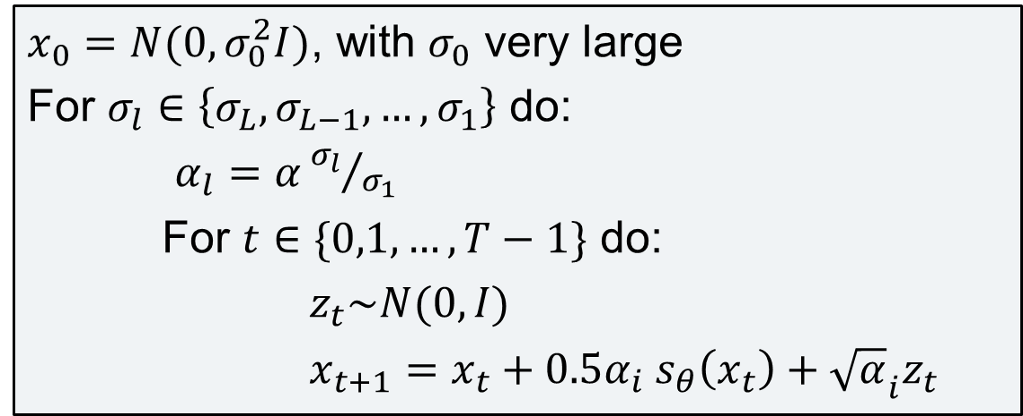
Sampling using progressive Langevin dynamics
$x_{0}=N(0,σ_{0}^{2}I)$, with $σ_{0}$ very large
For $σ_{l}∈\left\{σ_{L},σ_{L−1},…,σ_{1}\right\}$ do:
$α_{l}=α{σ_{l}}/{σ_{1}}$
For $t∈\{0,1,…,T−1\}$ do:
$z_{t}\sim N(0,I)$
$x_{t+1}=x_{t}+0.5α_{i} s_{θ}\left(x_{t}\right)+{\sqrt{α}}_{i}z_{t}$
Notice how the distribution is now actually proportional. To achieve this we needed:
$$s_{θ}\left(x\right)≠∇_{x}\log{p_{data}\left(x\right)}$$

Slide 26
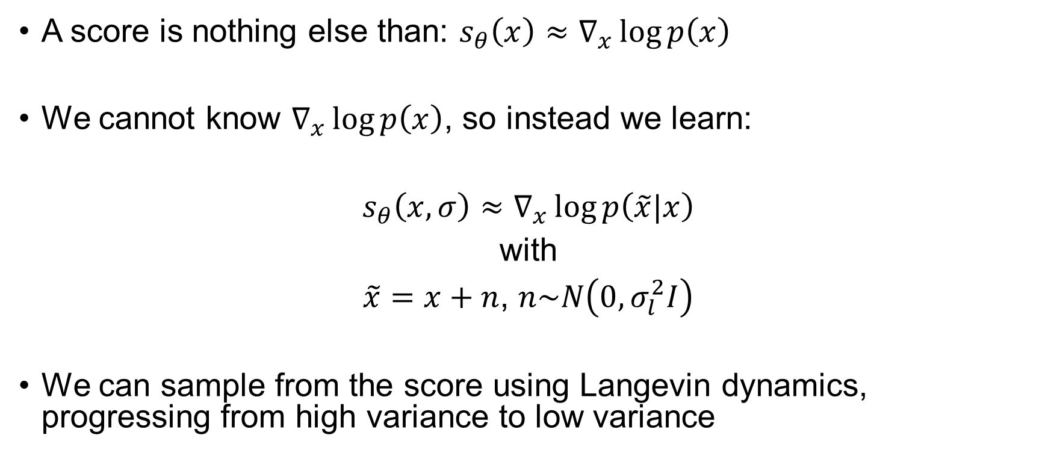
Closing thoughts on scores
A score is nothing else than: $s_{θ}\left(x\right)≈∇_{x}\log{p\left(x\right)}$
We cannot know $∇_{x}\log{p\left(x\right)}$, so instead we learn:
$s_{θ}\left(x,σ\right)≈∇_{x}\log{p\left(\tilde{x}|x\right)}$
with
$\tilde{x}=x+n$, $n\sim N\left(0,σ_{l}^{2}I\right)$
We can sample from the score using Langevin dynamics, progressing from high variance to low variance

Slide 27
Diffusion
“Denoising Diffusion Probabilistic Models” (DDPM)
Jonathan Ho, Ajay Jain, and Pieter Abbeel

Slide 28
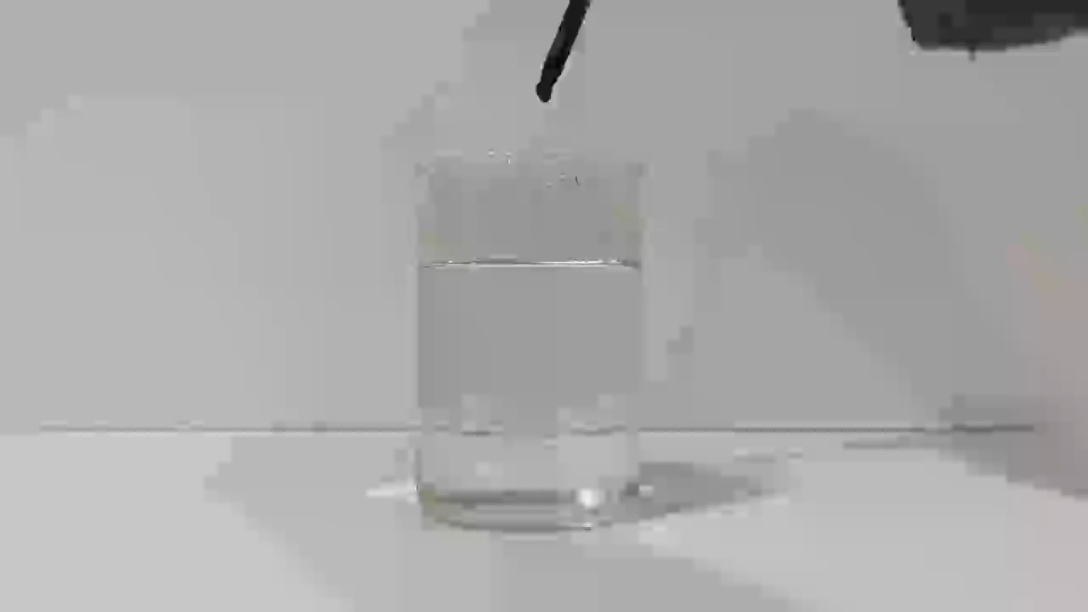
What is diffusion?

Slide 29
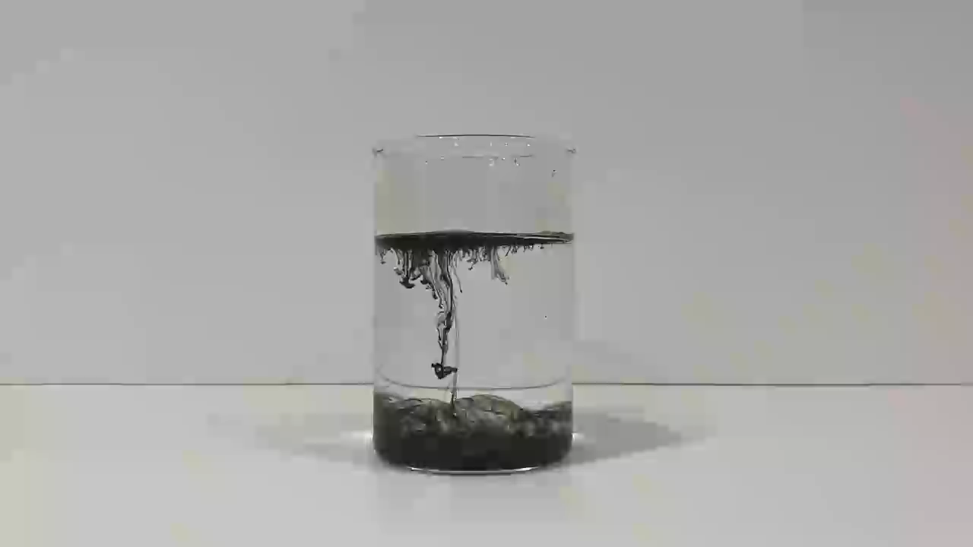
What is diffusion?

Slide 30
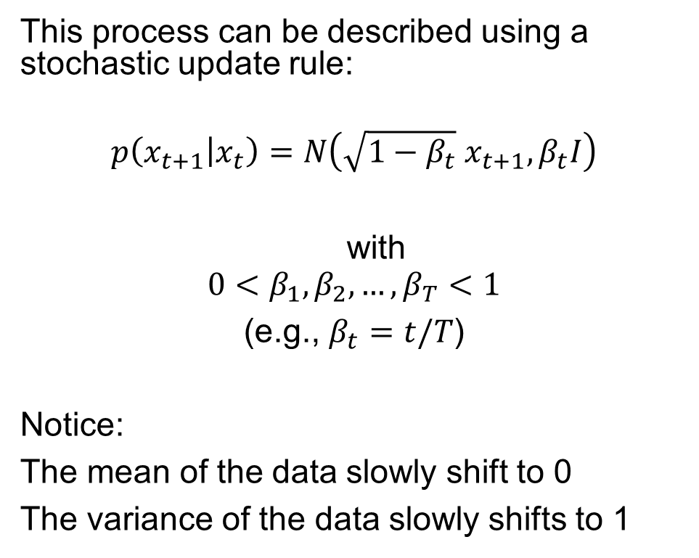
What is diffusion?
This process can be described using a stochastic update rule:
$$p\left(x_{t+1} | x_{t}\right)=N\left(\sqrt{1−β_{t}}{ x}_{t+1}, β_{t}I\right)$$
with
$$0<β_{1},β_{2},…,β_{T}<1$$
(e.g., $β_{t}=t/T$)
Notice:
The mean of the data slowly shift to 0
The variance of the data slowly shifts to 1

Slide 31
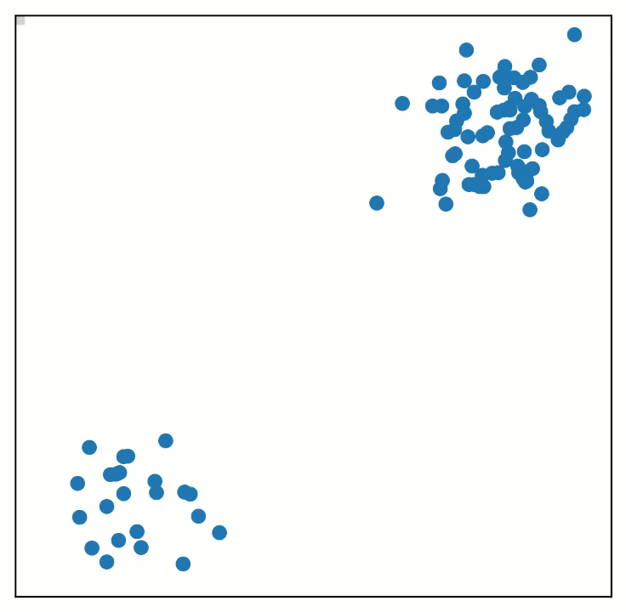
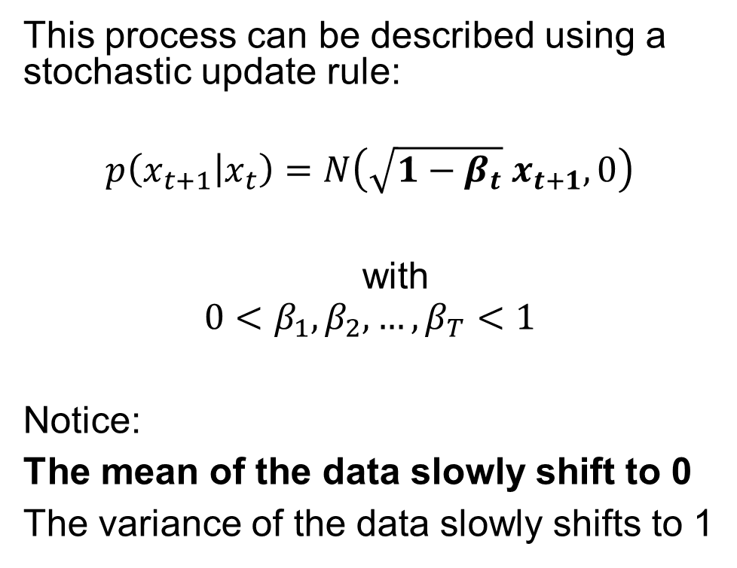
What is diffusion?
This process can be described using a stochastic update rule:
$$p\left(x_{t+1} | x_{t}\right)=N\left(\sqrt{1−β_{t}}{ x}_{t+1}, 0\right)$$
with
$$0<β_{1},β_{2},…,β_{T}<1$$
Notice:
The mean of the data slowly shift to 0
The variance of the data slowly shifts to 1

Slide 32
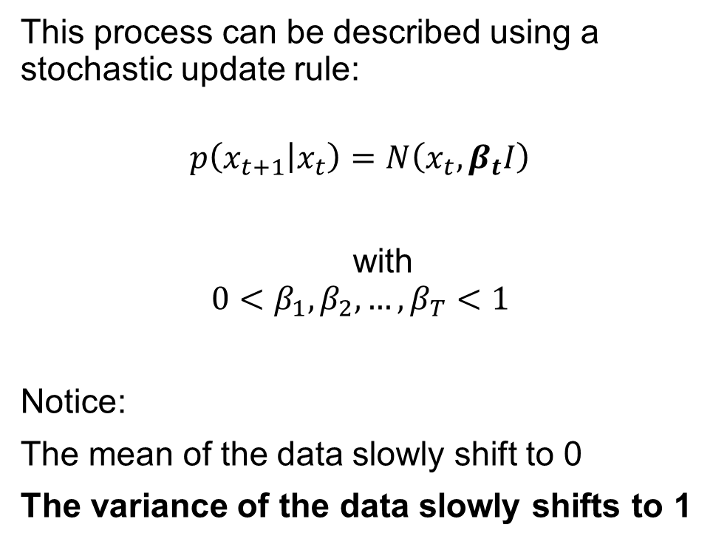
What is diffusion?
This process can be described using a stochastic update rule:
$$p\left(x_{t+1} | x_{t}\right)=N\left(x_{t}, β_{t}I\right)$$
with
$$0<β_{1},β_{2},…,β_{T}<1$$
Notice:
The mean of the data slowly shift to 0
The variance of the data slowly shifts to 1

Slide 33
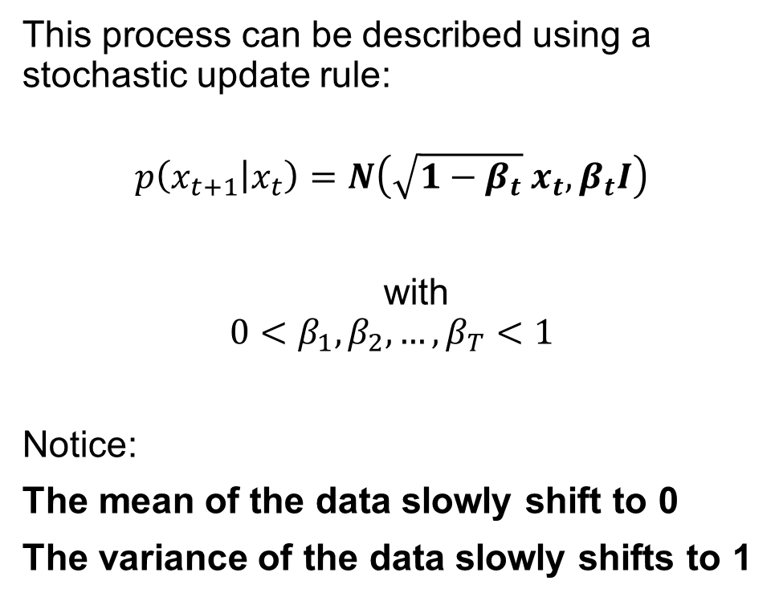
What is diffusion?
This process can be described using a stochastic update rule:
$$p\left(x_{t+1} | x_{t}\right)=N\left(\sqrt{1−β_{t}}{ x}_{t}, β_{t}I\right)$$
with
$$0<β_{1},β_{2},…,β_{T}<1$$
Notice:
The mean of the data slowly shift to 0
The variance of the data slowly shifts to 1

Slide 34
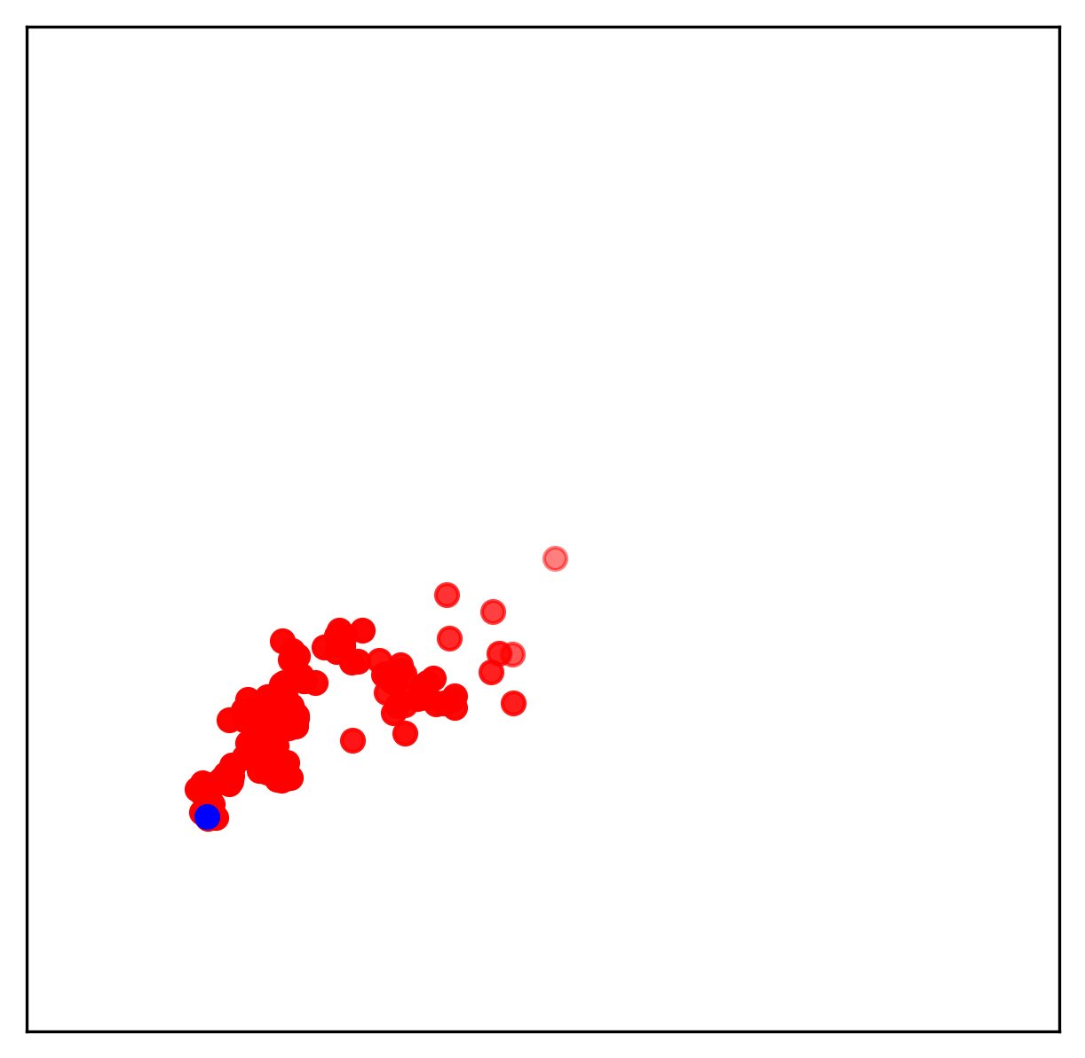
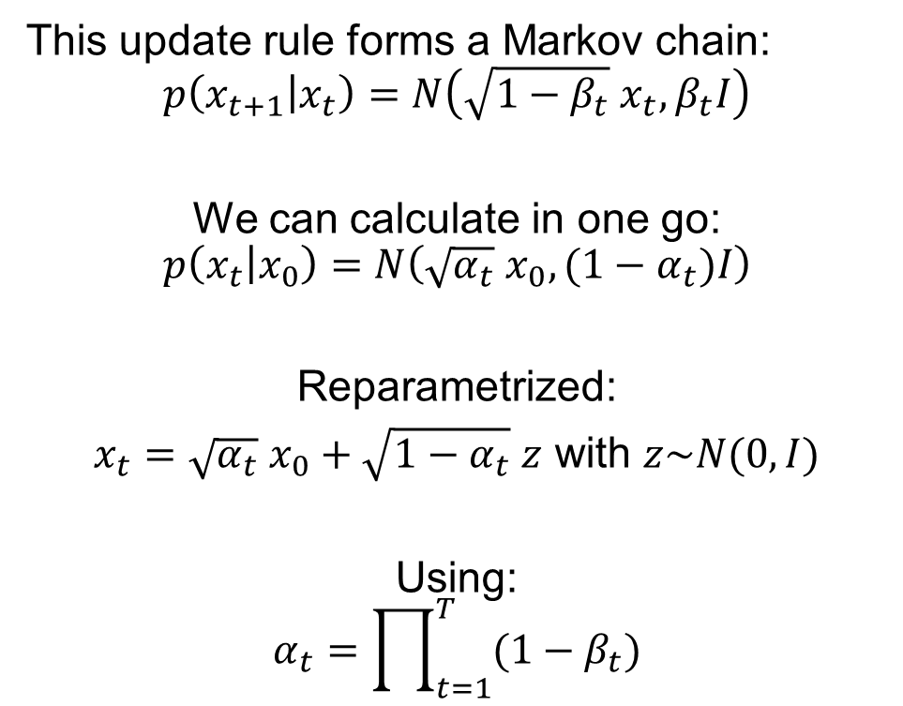
A nifty little trick
This update rule forms a Markov chain:
$$p\left(x_{t+1} | x_{t}\right)=N\left(\sqrt{1−β_{t}}{ x}_{t}, β_{t}I\right)$$
We can calculate in one go:
$$p\left(x_{t} | x_{0}\right)=N\left(\sqrt{α_{t}}{ x}_{0}, (1−α_{t})I\right)$$
Reparametrized:
$x_{t}={\sqrt{α_{t}} x}_{0}+\sqrt{1−α_{t}} z$ with $z\sim N(0,I)$
Using:
$$α_{t}=\prod_{t=1}^{T}{(1−β_{t})}$$

Slide 35
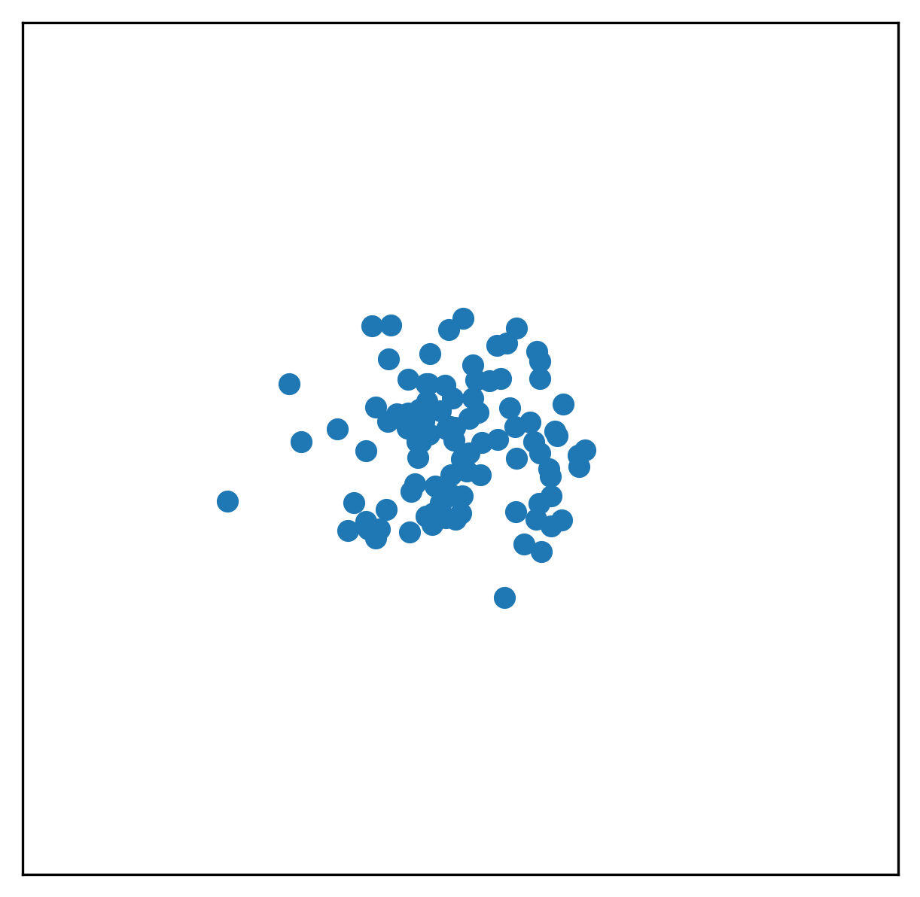
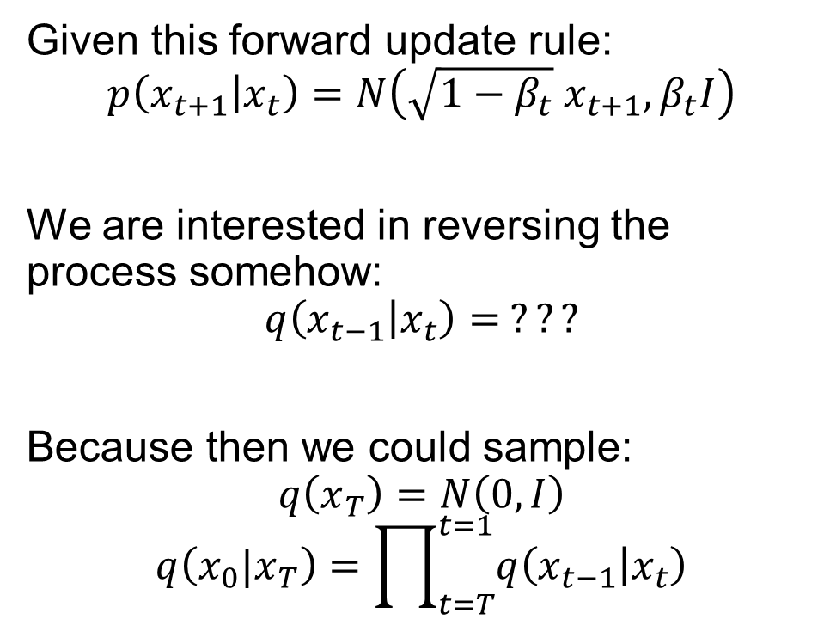
So, how do we sample?
Given this forward update rule:
$$p\left(x_{t+1} | x_{t}\right)=N\left(\sqrt{1−β_{t}}{ x}_{t+1}, β_{t}I\right)$$
We are interested in reversing the process somehow:
$$q\left(x_{t−1} | x_{t}\right)= ???$$
Because then we could sample:
$$q\left(x_{T}\right)=N\left(0,I\right)$$
$$q\left(x_{0}|x_{T}\right)=\prod_{t=T}^{t=1}{q\left(x_{t−1} | x_{t}\right)}$$

Slide 36

So, how do we sample?
Turns out, going via $x_{0}$ makes things simpler
$$q\left(x_{t−1} | x_{t}\right)=p\left(x_{t−1}\right|x_{0}) q\left(x_{0}\right|x_{t})$$
Now we can parametrize $q\left(x_{0}\right|x_{t})$ as:
$$\hat{x_{0}}=denoiser_{θ} \left(x_{t},t\right)$$
Which we can train easily using a MSE between sampled $x_{t}$ and ground truth $x_{0}$
Use the forward noising process to go back to t-1
Go from the current noisy sample to an end estimate

Slide 37

So, how do we sample?
$x_{T}=N\left(0, I\right)$
For $t∈\{T,T−1,…,1\}$ do:
$\hat{x_{0}}=denoiser_{θ}(x_{t},t)$
$x_{t−1}=noiser(\hat{x_{0}},t−1)$

Slide 38

So, how do we sample?
$x_{T}=N\left(0, I\right)$
For $t∈\{T,T−1,…,1\}$ do:
$\hat{x_{0}}=denoiser_{θ}(x_{t},t)$
$z\sim N(0,I)$
$x_{t−1}={\sqrt{α_{t−1}} \hat{x_{0}}}_{ }+\sqrt{1−α_{t−1}} z$

Slide 39


Diffusion and score
$x_{T}=N\left(0, I\right)$
For $t∈\{T,T−1,…,1\}$ do:
$\hat{x_{0}}=denoiser_{θ}(x_{t},t)$
$z\sim N(0,I)$
$x_{t−1}={\sqrt{α_{t−1}} \hat{x_{0}}}_{ }+\sqrt{1−α_{t−1}} z$
Notice that:
$$E\left[x_{t−1}−x_{t}\right]=\sqrt{α_{t−1}} denoiser_{θ}\left(x_{t},t\right)−x_{t}$$
Thus, we know the score, and we can translate between score and denoiser

Slide 40



Diffusion and score
$x_{T}=N\left(0, I\right)$
For $t∈\{T,T−1,…,1\}$ do:
$z\sim N(0,I)$
$x_{t−1}$ = $x_{t}+dx+\sqrt{1−α_{t−1}} z$
With:
$$dx=E\left[x_{t−1}−x_{t}\right]=\sqrt{α_{t−1}} denoiser_{θ}\left(x_{t},t\right)−x_{t}$$
Remember scores?
$$x_{t+1}=x_{t}+α s_{θ}\left(x_{t}\right)+\sqrt{α}z_{t}$$

Slide 41

Sampling

Slide 42
Conclusion

Slide 43
Diffusion & Score
A score is simply a gradient field pointing in the direction of where the data ‘lives’
Diffusion is way to progressively add randomness (remove information) from data
A score-based diffusion model learns a score based on the diffusion process. It then uses an update rule to reverse the process.

Slide 44

You can learn a score on any type of ‘diffusion’ -> cold diffusion

Slide 45
The End

